Slide 1
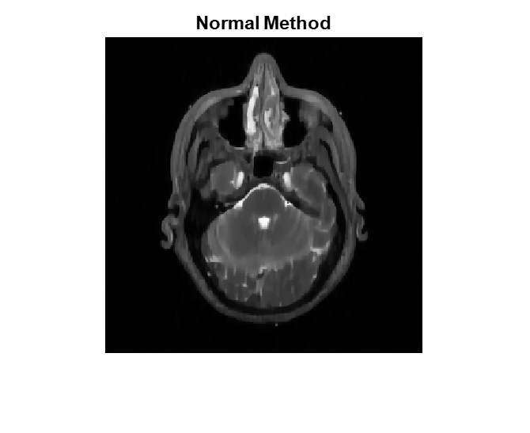
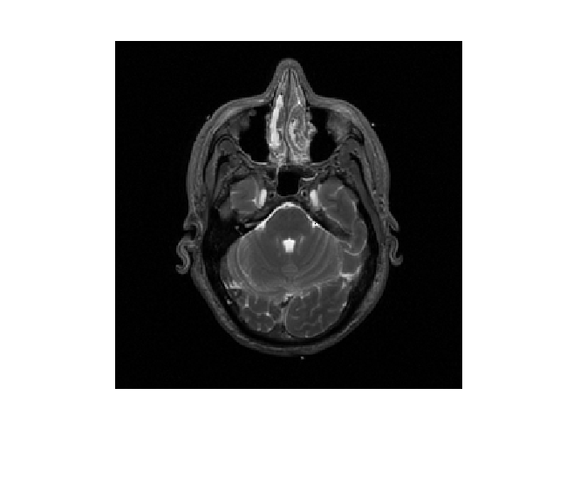
REFERENCE BASED COMPRESSED SENSING
HENRY HANH , Prof. FENG LIU
PROBELM DEFINITION & BACKGROUND INFORMATION
MRI (Magnetic Resonance Imaging) is a widely used medical imaging technique used to image body organs without exposure to ionizing radiation. In recent years, Compressed Sensing in MRI has been introduced to reduce scan time.
Compressed Sensing involves taking less measurements required for full reconstruction according to Nyquist's Theorem to reconstruct a near perfect image using non-linear reconstruction methods. However, the conventional CS method (Sparse-MRI) does not use previous scan information which may speed up the scan time.
GOALS
Produce a better MRI image than conventional method (SPARSE-MRI) using existing image processing techniques and previous information from similar reference images.
METHODOLOGY
We propose a novel method using the weighting factors of Total Variation and L1 Norm in the conventional method (Sparse-MRI) to improve image quality. This proposed method uses edge information from a similar image previously taken to alter edge weightings. To register the edge information to conventional reconstruction, the Affine transform was used. The optimal weighting factors for this image were found through experiments throughout semester.
Figure 1: Block Diagram of proposed method
RESULTS
Image Results
[a] [b]
[c]
[d] [e]
Figure 2: [a] original image to be constructed [b] reference image [c] reference edge registration using affine transforms [d] Conventional method reconstruction [e] proposed method reconstruction at R= 4 , random 1-D phase sampling
Table 1: Image Quality Results
CONCLUSIONS
Maximization of L1 weightings and minimization TV weighting produce the best reconstructed image.
Proposed method provides an improvement of at least 4 dB in PSNR and 0.15 in SSIM value.
Proposed method reduces image blurring in random phase encoding. Thus also able to implemented practically in MRI machines.
Future work to optimize the algorithm and weightings.
Reconstruct image using Conventional Method
Get edge information from reference image using Canny Filter operation
Align Image and edge information using Affine transforms
Reconstruct Image again using different weighting factors on edges
Image Quality Metrics | Conventional Method (Sparse-MRI) | Proposed Method (Random 1D Phase Sampling) | Proposed Method (Random 2D Sampling)
PSNR (Peak Signal Noise Ratio) dB | 34.14 | 39.82 | 38.6681
SSIM (Structural Similarity Index) (0-1) | 0.437 | 0.602 | 0.8885

